Slide 1
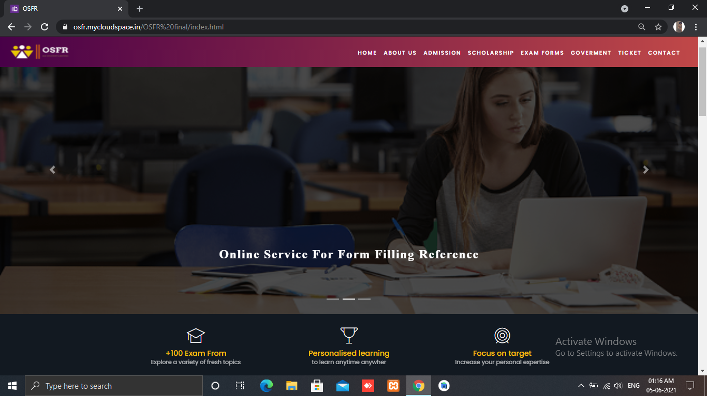

Online Services For Form Filling Reference. (OSFR)

Slide 2
Contents of Project
Introduction.
Problem Statement.
Project Plan.
Literature Survey.
Project Concept.
Project Functional Requirements.
Features.
Project Feasibility.
Block Diagram.
Advantages.
Limitations.
Applications.
Bibliography and References.
Conclusion

Slide 3
Introduction
Technology has opened a wide range of possibilities for the college students and all citizens by availing the various facility provided by the colleges/ Institutions/Government etc.
Thus, the working style has changed in a variety of ways.
In some cases, the application form or exam form or any form required by the government have been converted to fully online mode.
Concern authority and the applicant do not have any face-to-face contact in such cases.
In other cases, we can see that some part of the application process has converted a portion of their process online and some portion is still offline.

Slide 4
Problem Statement
It is now very popular to fill in online forms such as school/college admission forms for students, test forms, different forms for the use of government facilities as well: Aadhar Card, voter Id, Pan Card, etc. Existing system provides this facility to every user with online and offline mode. While everyone wants to go for online mode, most of the students and the people facing the issues during such online submission of applications and forms are due to poor knowledge and lack of guidance.
In this project, we aim to create a system that will take care of all the problems experienced when submitting an online form. In contrast to conventional manual methods, this web application is more effective and easy for everyone to direct and fill in the form. This website enables user to cast their requirement from anywhere, anytime without having any problem. This website is purely user-friendly since the sample forms are there for all type of services.

Slide 5
Literature survey
Nowadays websites are being used for reserving travel tickets, competitive examination, government policies.
Many times we have to fill online Application form.
Filling any online form is hectic job and require to understand different aspects of the form .
Its very confusing and time-consuming process.
Generally, users are required to fill their information into web forms which often contains multiple data input fields and information to interact the web applications and services.

Slide 6
Project Concept
The proposed method is to an online File Repository within a college institution which allows teachers upload Documents and other files resources to the repository.
The web-based application has been chosen to manage all the IS department research documents.
Web-based applications are by far the foremost universally accessible.
Among these applications, the most common and known ones are so called web-based applications.

Slide 7
Project Plan
Week | Work to be done
1 | We searched multiple Topics
2 | Studying the feasibility of the searched topics
 | Finalization of the topic
3 | Study about the requirements for the implementation of the project
4 | Working on the gathered requirements
 | Finalizing the work flow module of the proposed system
5 | Working on the multiple platforms for proposed system
 | Finalization of the platform and all relevant information for the proposed system
6 | Creating the documentation of the work done in this semester

Slide 8
Project Functional Requirement
Hardware Requirement :
Processor : Intel CORE i3
RAM : 4 GB
Hard Disk : 1 TB
Software Requirement :
Operating System : Microsoft Windows-7.
Software Package : MySQL, PHP , XAMPP

Slide 9

Features
It is possible to easily fill forms , from our Website.
OSFR System will Lower the mistakes done by the Students and people while filling the form.
This Software application will cut the dependency on others for form filling.
This will be easily accessible for everyone.

Slide 10
Project Feasibility
Feasibility study is a method to check various different requirements and availability of financial & technical resources.
In economic feasibility, analysis of the cost of the system is carried out. The system should be only developed if it is going to give returned the current manual system user can get the price only by purchasing the newspapers.
In Technical feasibility minimum requirement is such that it can be affordable by the user who is having computer.
In Operational feasibility, Once the system is designed there must be trained and expert operator. From the user’s perspective our system fully operational feasible as it just requires some knowledge of computer.

Slide 11
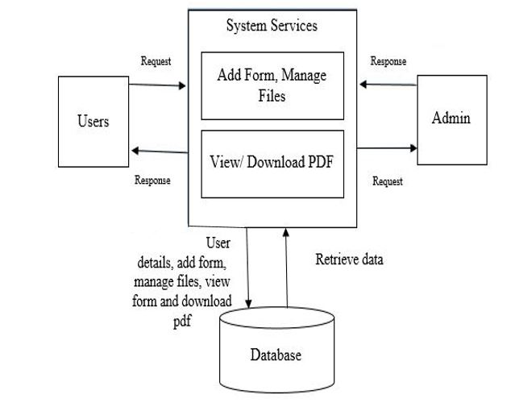
Block Diagram

Slide 12
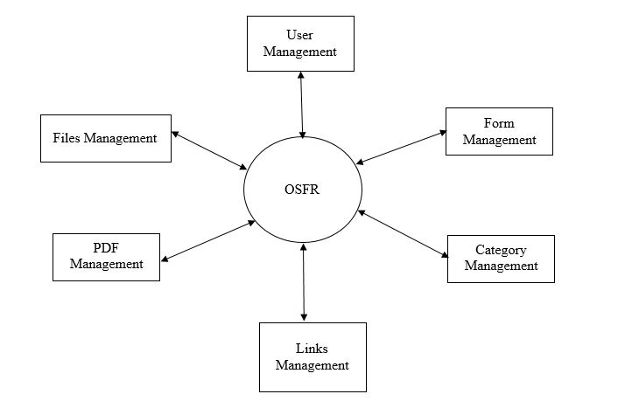
DFD Level 0 Diagram

Slide 13
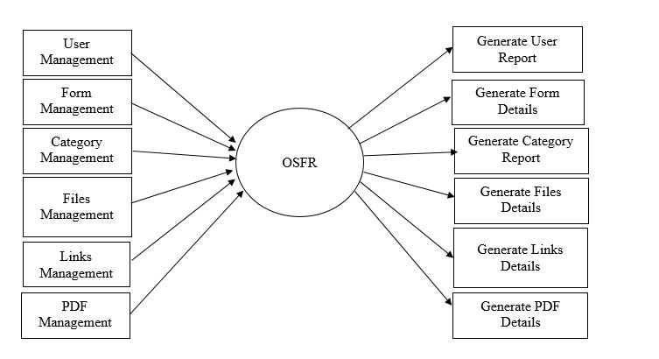
DFD Level 1 Diagram

Slide 14
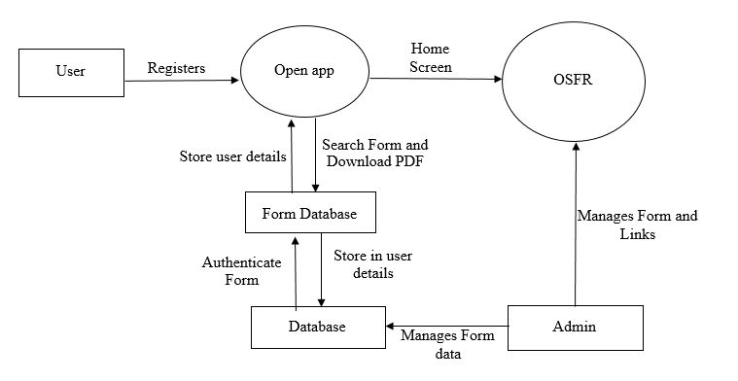
DFD Level 2 Diagram

Slide 15
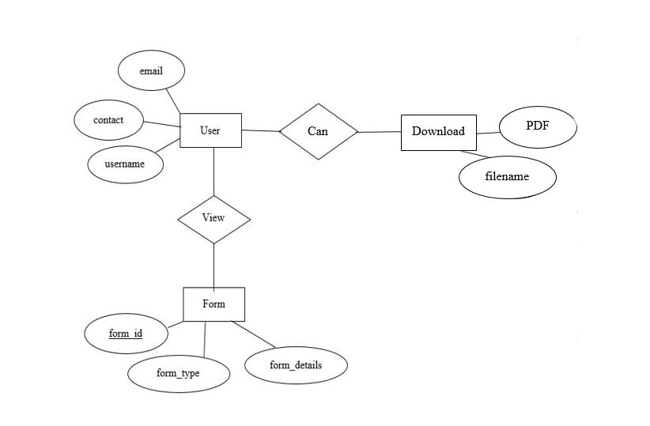
Entity Relationship Diagram

Slide 16

This Is the User Interface of our Project

Slide 17


Slide 18
Test Cases
Step | Test Cases ID | Description |  | Steps | Input Data | Expected Result | Actual Result | Status
Home Module
1 | TC_1_1 | To test the Home module |  | 1.Open the web site 2.Click on Home Module | Click on Home module | Home Window should be displayed | Home Window Gets Displayed | PASS
Admission Module
2 | TC_2_1 | To test the Admission module | 1.Open the web site 2.Click on Admission Module |  | Click on Admission Module | Admission Window should be displayed | Admission Window gets displayed | PASS
3 | TC_2_2 | To Test the Post Matric Admission | 1.Open the Admission Window 2.Click on Post Matric Admission Module |  | Click on Admission and click on Post Matric Admission | Post Matric Admission Window should be displayed | Post Matric Admission Window gets displayed | PASS

Slide 19
Step | Test Cases ID | Description |  | Steps | Input Data | Expected Result | Actual Result | Status
Scholarship Module
4 | TC_3_1 | To test the Scholarship module |  | 1.Open the website 2. Click on Scholarship module | Open website and Click on Scholarship module | Scholarship window should be displayed | Scholarship window get displayed | PASS
5 | TC_3_2 | To test the MAHADBT module |  | 1.Open the Scholarship module 2. Click on MAHADBT module | Open Scholarship module and Click on MAHADBT module | MAHADBT window should be displayed | MAHADBT window get displayed | PASS
Government Module
6 | TC_4_1 | To test the Government module | 1.Open the website 2. Click on Government module |  | Open website and Click on Government module | Government window should be displayed | Government window get displayed | PASS
Step

Slide 20
Step | Test Cases ID | Description | Steps | Input Data | Expected Result | Actual Result | Status
7 | TC_4_2 | To test the Aadhar Card module | 1.Open the Government module 2. Click on Aadhar Card module | Open Government module and Click on Aadhar Card module | Aadhar Card window should be displayed | Aadhar Card window get displayed | PASS
8 | TC_4_3 | To test the Pan Card module | 1.Open the Government module 2. Click on Pan Card module | Open Government module and Click on Pan Card module | Pan Card window should be displayed | Pan Card window get displayed | PASS
Ticket Module
9 | TC_5_1 | To test the Ticket module | 1.Open the website 2. Click on Ticket module | Open website and Click on Ticket module | Ticket window should be displayed | Ticket window get displayed | PASS

Slide 21
Step | Test Cases ID | Description | Steps | Input Data | Expected Result | Actual Result | Status
10 | TC_5_2 | To test the Train Ticket Booking module | 1.Open the Ticket module 2. Click on Train Ticket Booking module | Open Ticket module and Click on Train Ticket Booking module | Train Ticket Booking window should be displayed | Train Ticket Booking window get displayed | PASS
About us
11 | TC_6_1 | To test the About Us module | 1.Open the website 2. Click on About Us Module | Open website and Click on About Us module | About Us window should be displayed | About Us window get displayed | PASS

Slide 22
Cost Estimation
For our Organic project of 1.138 KLOC
LOC=1138
1.).KLOC=LOC/1000
=1138/1000
=1.138 KLOC
2.)Effort Applied (E)
=2.4*(KLOC)^1.05
=2.4*(1.138) ^1.05
= 2.75 Man Per Month

Slide 23
2.)Development Time (D)
=2.5*(E)^0.38
=2.5*(2.75) ^0.38
=3.67 Month
3.)People Required (P)
=E/D
=2.75/3.67
=0.75 Count
Cost Of Overall project,
Consider, Per Person Salary = Rs.5500
So,
Total Effort Cost= Number of Staff*Salary Per Month
= 2.75*5500
= 15,125
Total Cost = Total Effort Cost*People Required
=15,125*0.75
=11,343
So, Using Basic COCOMO Model we estimate our project Cost. Cost of project is Rs. 11,343

Slide 24
Advantages
This Website helps the user to fill the forms with ease and proper guidance.
It will make sure that the user does not commit any mistake as the these forms are important.
All the data here will be up to date and with recent updates so the user doesn’t miss any of them.
This will be one stop destination for everyone and also user-friendly as well as free for everyone.

Slide 25


Limitations
It requires active internet connection or else you can’t access it.
You should be Literate to understand the website.

Slide 26

Applications
Anyone who wants to fill form can use it as reference.
To view the procedure to fill forms properly.
It can be used by Schools and Colleges for students.

Slide 27
Future scope
We can use our propose system in every online services where filling online form is required.
In future every organisation, department and government offices adopt online methods for form filling.
As number of application required online form filling ,user require some assistance in filling online form.
Our proposed system will provide solution for this problem and create great user experience.

Slide 28
Conclusion
This system address the problem of Online form filling by exploring the relationships between the fields and input values.
It is an intelligent system to help users to fill the web forms and save time.
This system uses to fill any type online forms.
This web application mainly used for reducing the manual form filling process.
The browser helps users quickly view and fill out the documents that are already online at publicly available URLs.

Slide 29
Bibliography and Reference
Barbosa, L. and Freire, J.: Siphoning Hidden-Web Data through keyword-based interfaces. SBBD, 309–321, (2004).
Toda, G.A. and Cortez, E. and da Silva, A.S. and de Moura, E.: A probabilistic approach for automatically filling form-based web interfaces. Proc. of the VLDB Endowment, 4(3): 151–160. (2010).
HARTMANN M. and MUHLHAUSER M. (2009) ’Context-Aware Form Filling for Web Applications’, ICSC’ 09. IEEE International Conference on Semantic Computing, 2009, pp. 221-228.
Nilesh Rathod, Seema Shah, Kavita Shirsat,” An Interactive Online Training & Placement System”, International Journal of Advanced Research in Computer and Communication Engineering, Vol. 3, Issue 12, December-2013.

Slide 30
THANK YOU..!

